Slide 1
Avnet VisibleThings Example 1 GPIO Output PMOD1 (HAL version)
By
Michael Li
(3/11/2018) https://www.miketechuniverse.com

Slide 2
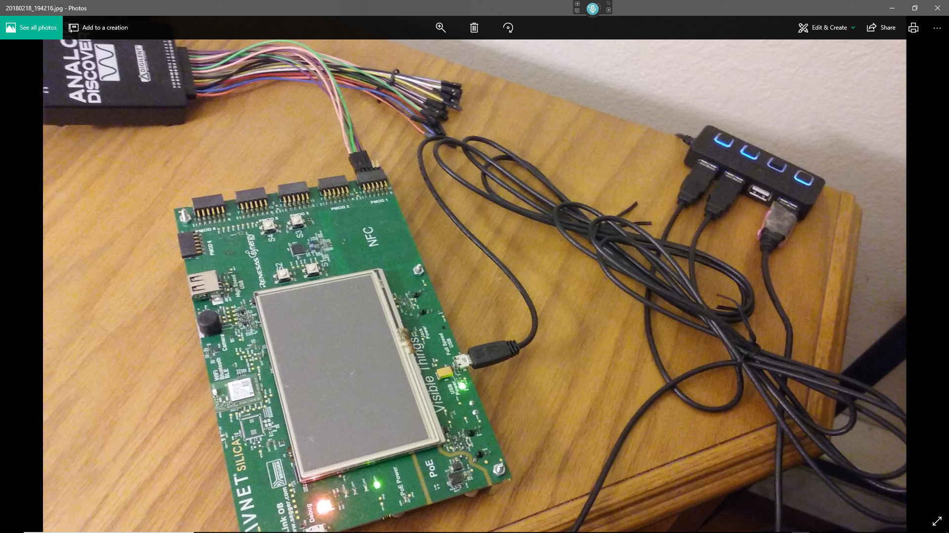
Setup (PMOD1 connected to Logic Analyzer)

Slide 3
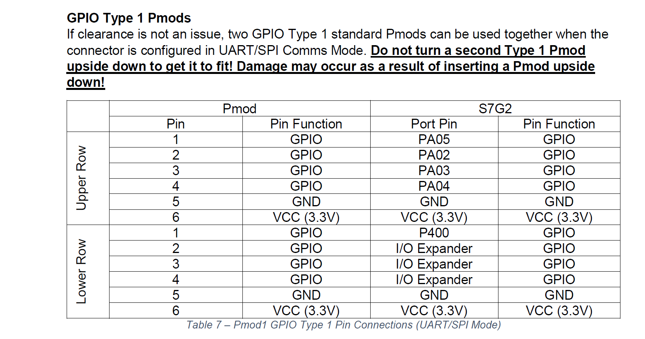
PMOD1 Pins
Lower Row (I/O Expander pins)
Pin #2 IO6 Port 0.3 RESET U18 (I2C addr = 0x25)
Pin #3 IO7 Port 1.6 IO7 U18 (I2C addr = 0x25)
Pin #4 IO8 Port 1.7 IO8 U18 (I2C addr = 0x25)

Slide 4
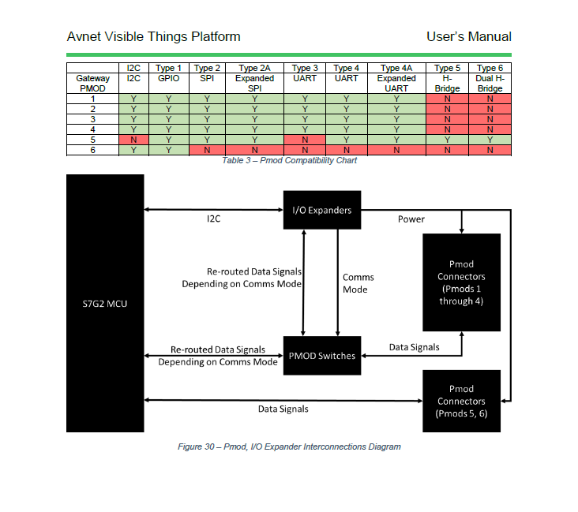

Slide 6
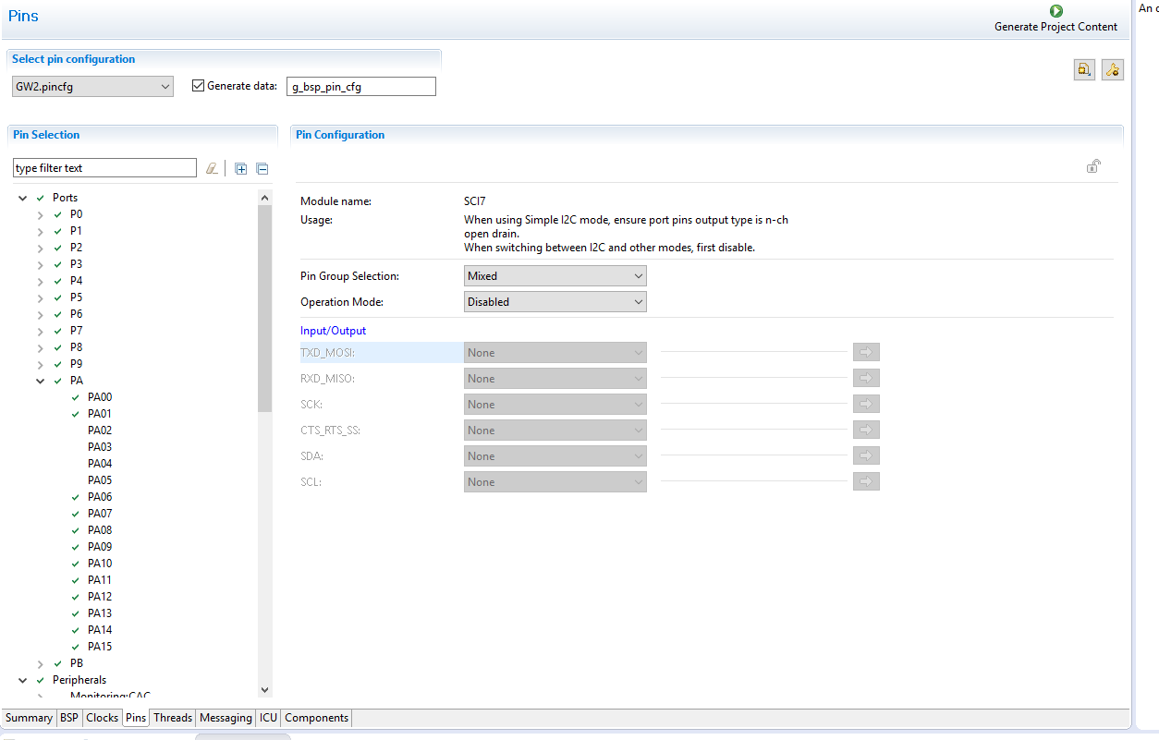
Disable SCI7. So, PA02-5 can be set as GPIO pins

Slide 7
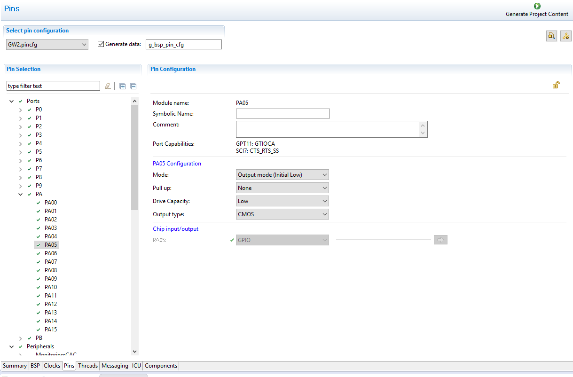
Set PA05/04/03/02 as GPIO output pins

Slide 8
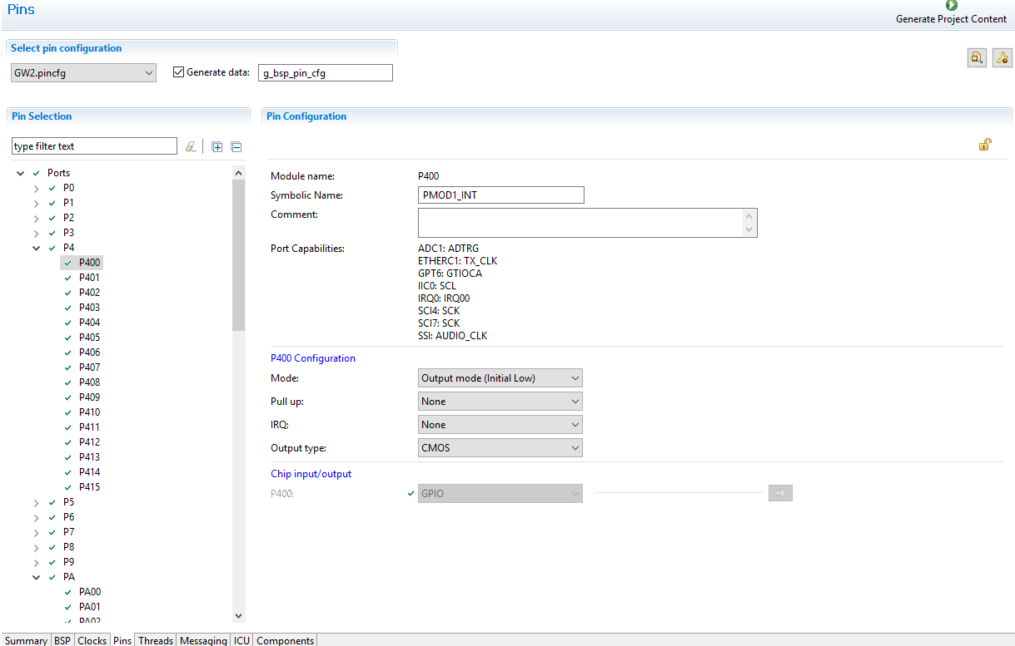
Set P400 as a GPIO output pin

Slide 9
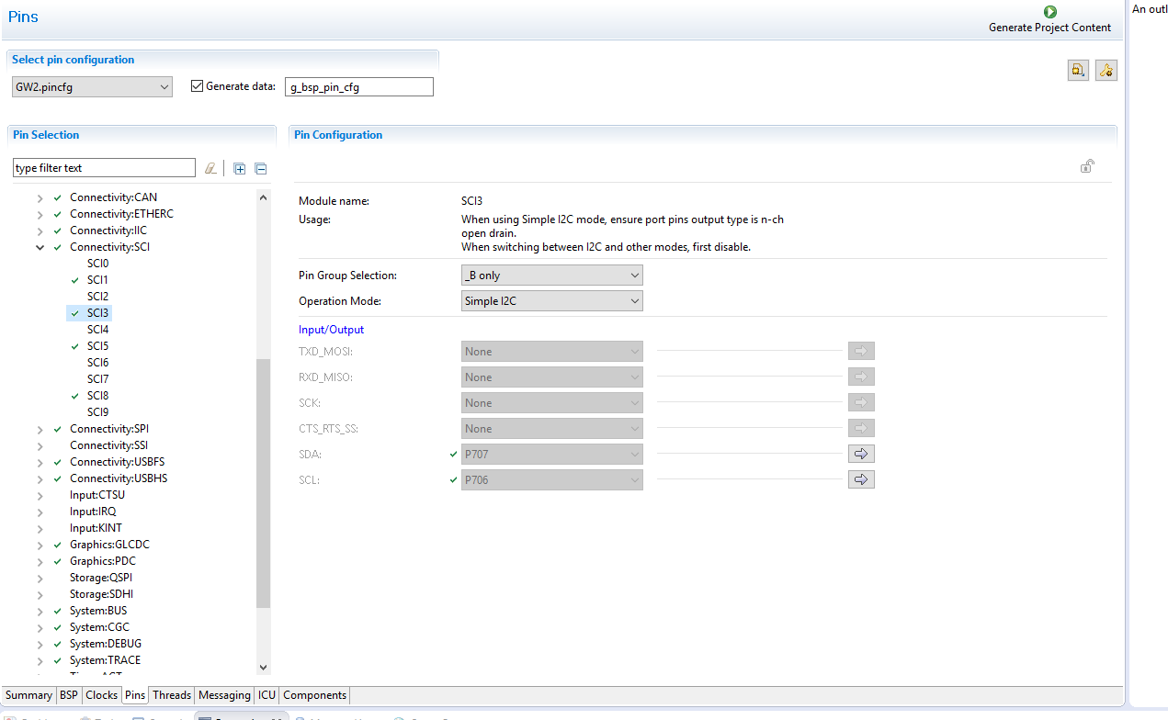
IO Expanders (U18/U19) are connected to the SCI3 port.

Slide 11
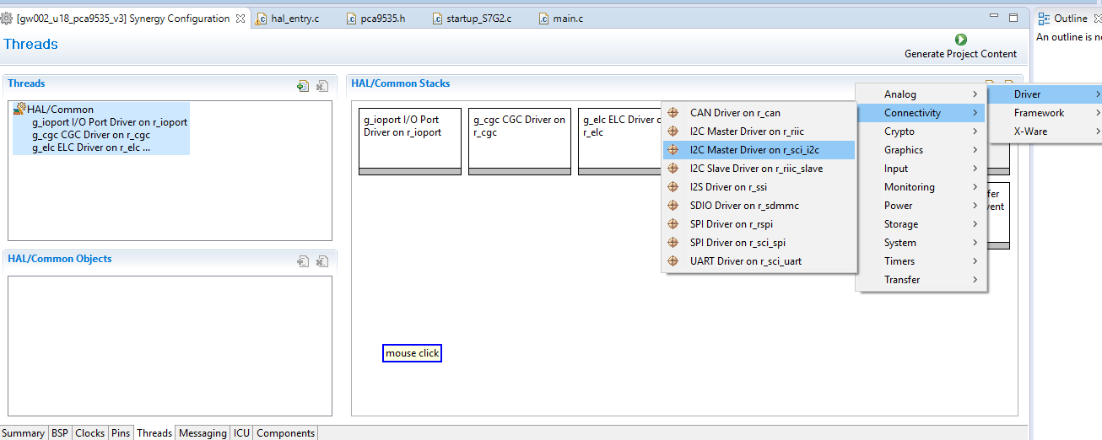
Add r_sci_i2c driver for IO Expander U18/U19

Slide 12
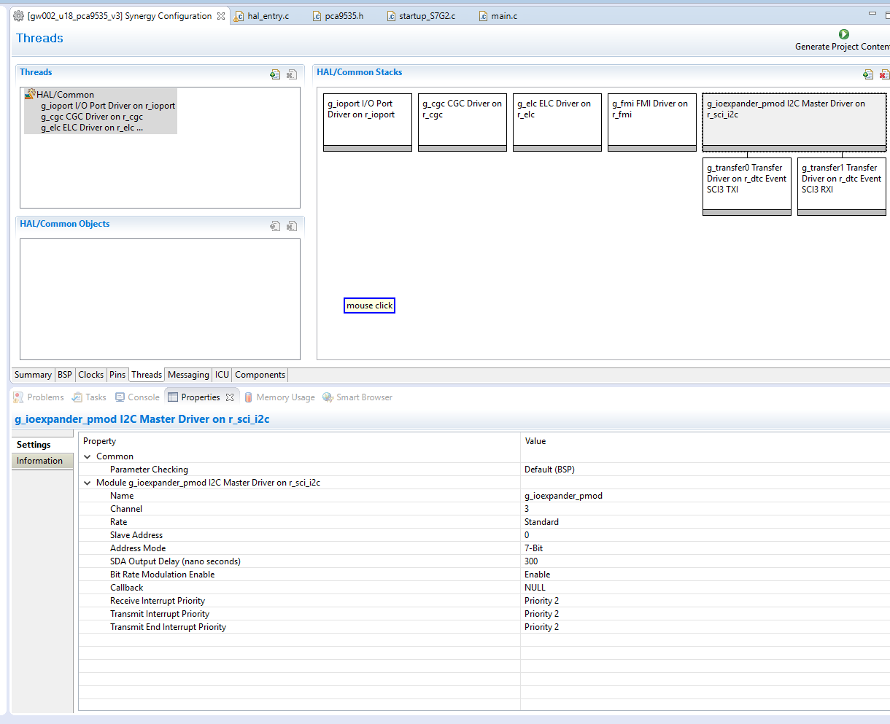
Properties
enter 3 for channel since SCI3 module is used.
Slave address is set in the code, not here because U18/U19 has different I2C slave addresses.

Slide 14
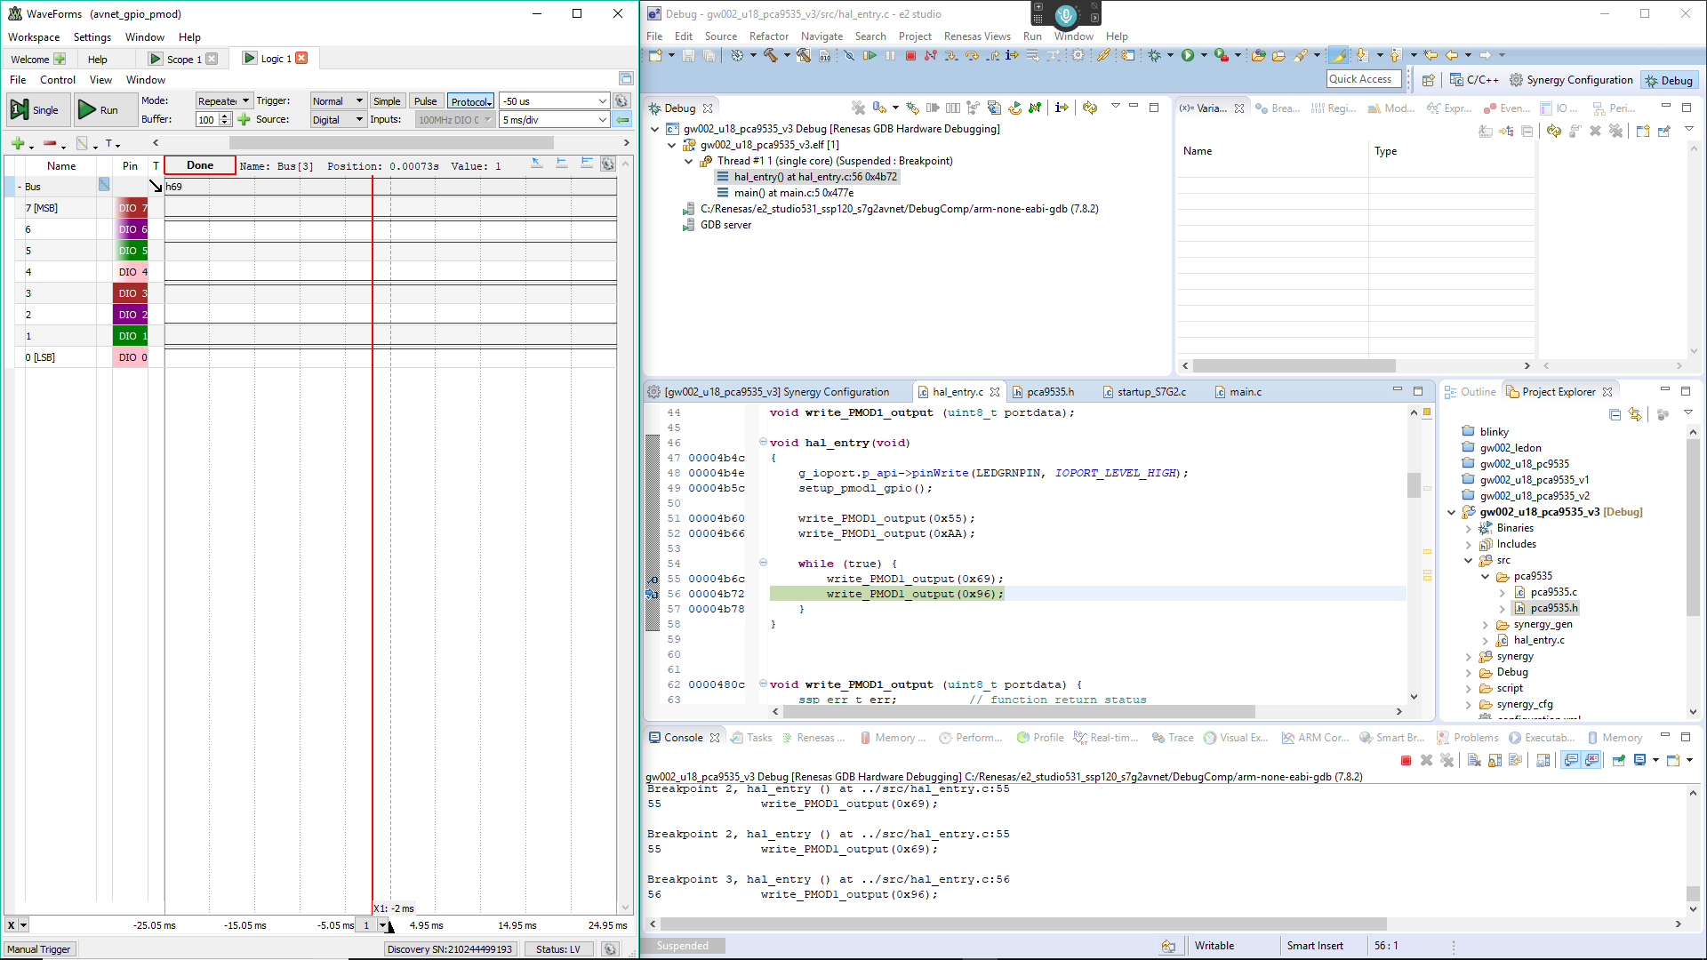
Testing (Debug mode)

Slide 15
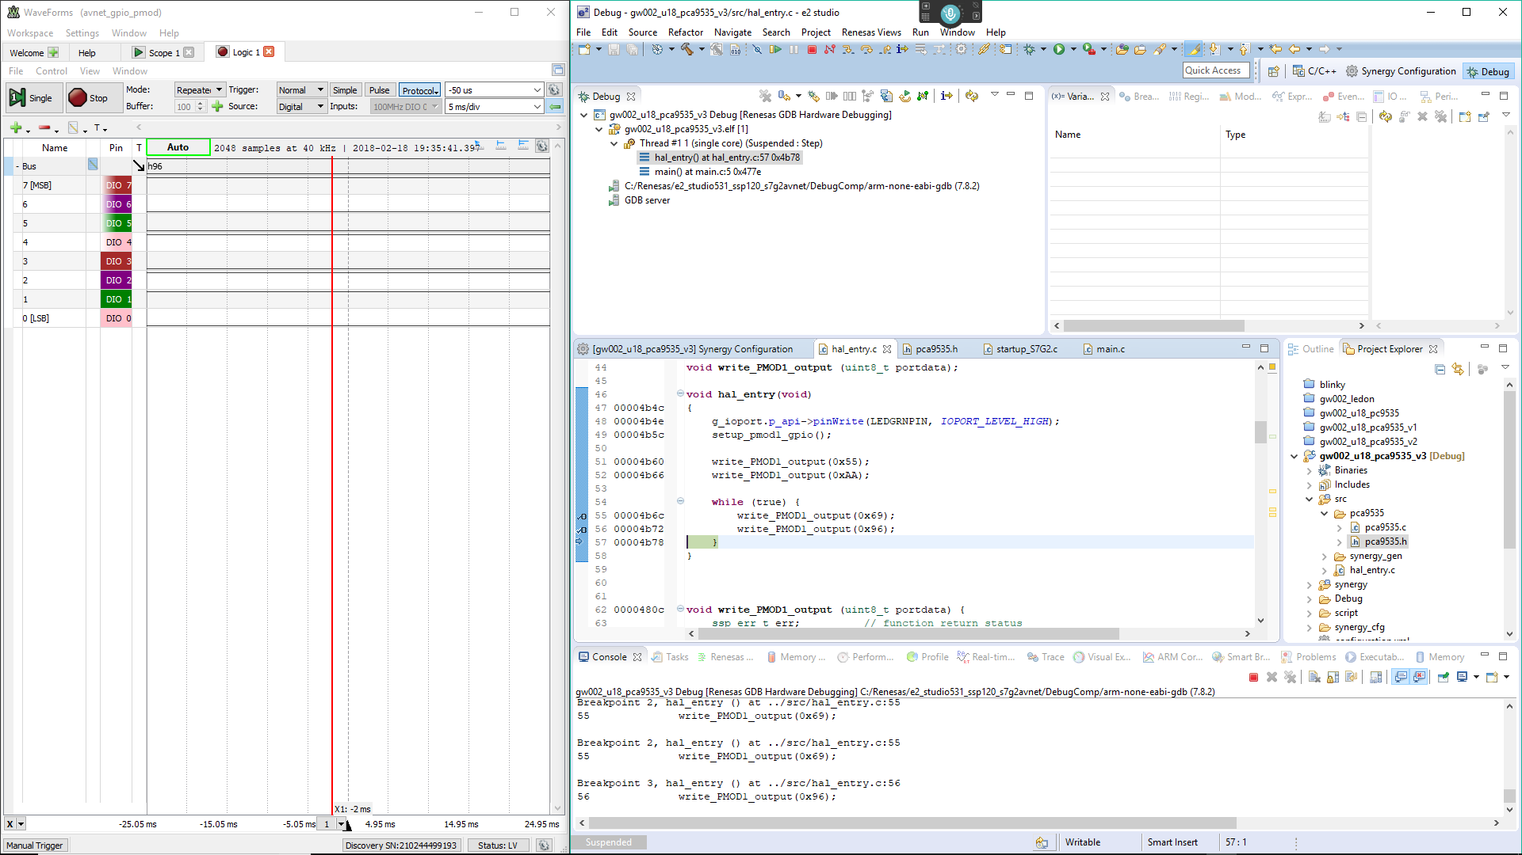
Testing (Debug mode)

